Slide 1
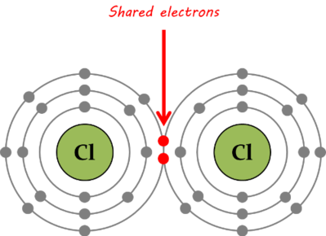
Students will be able to explain chemical bonding
I can define covalent, ionic and metallic bonding
I can illustrate covalent, ionic and metallic bonding

Slide 2
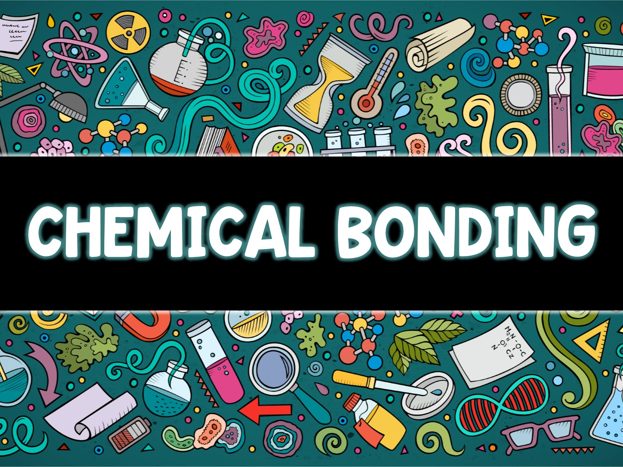

Slide 3
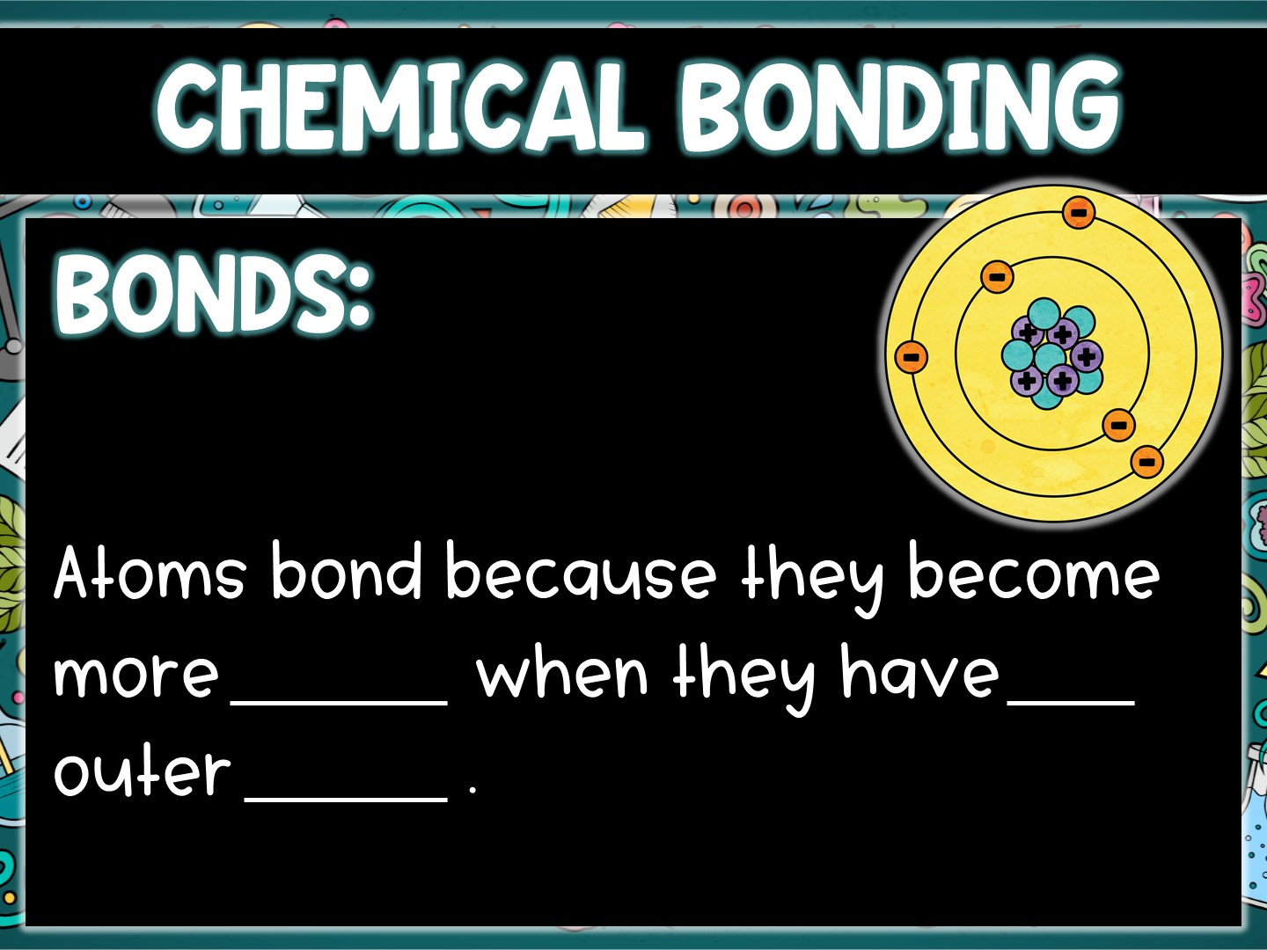
stable
full
shells

Slide 4
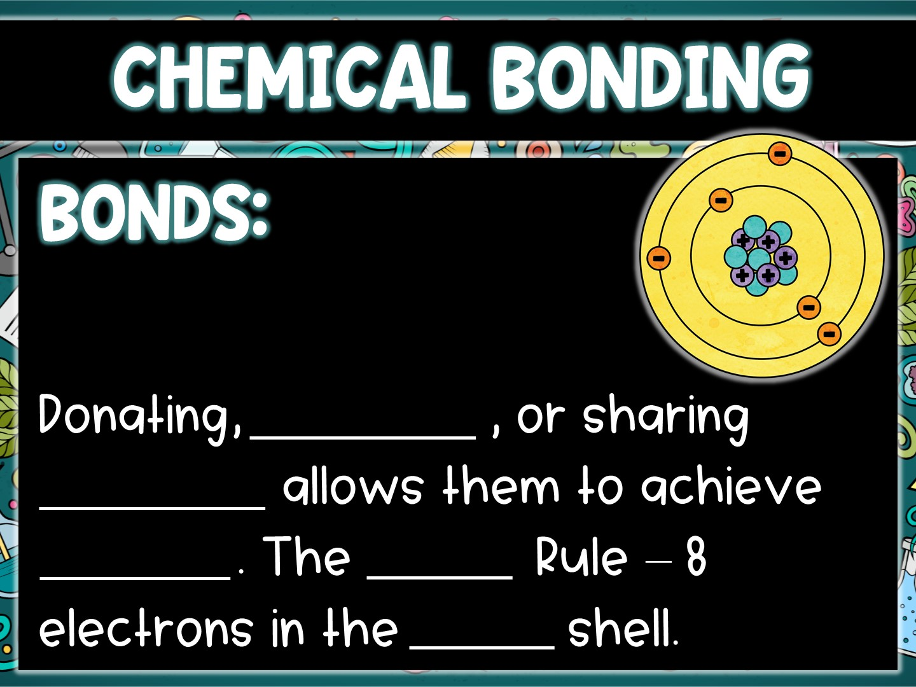
receiving
electrons
stability
Octet
outer

Slide 5
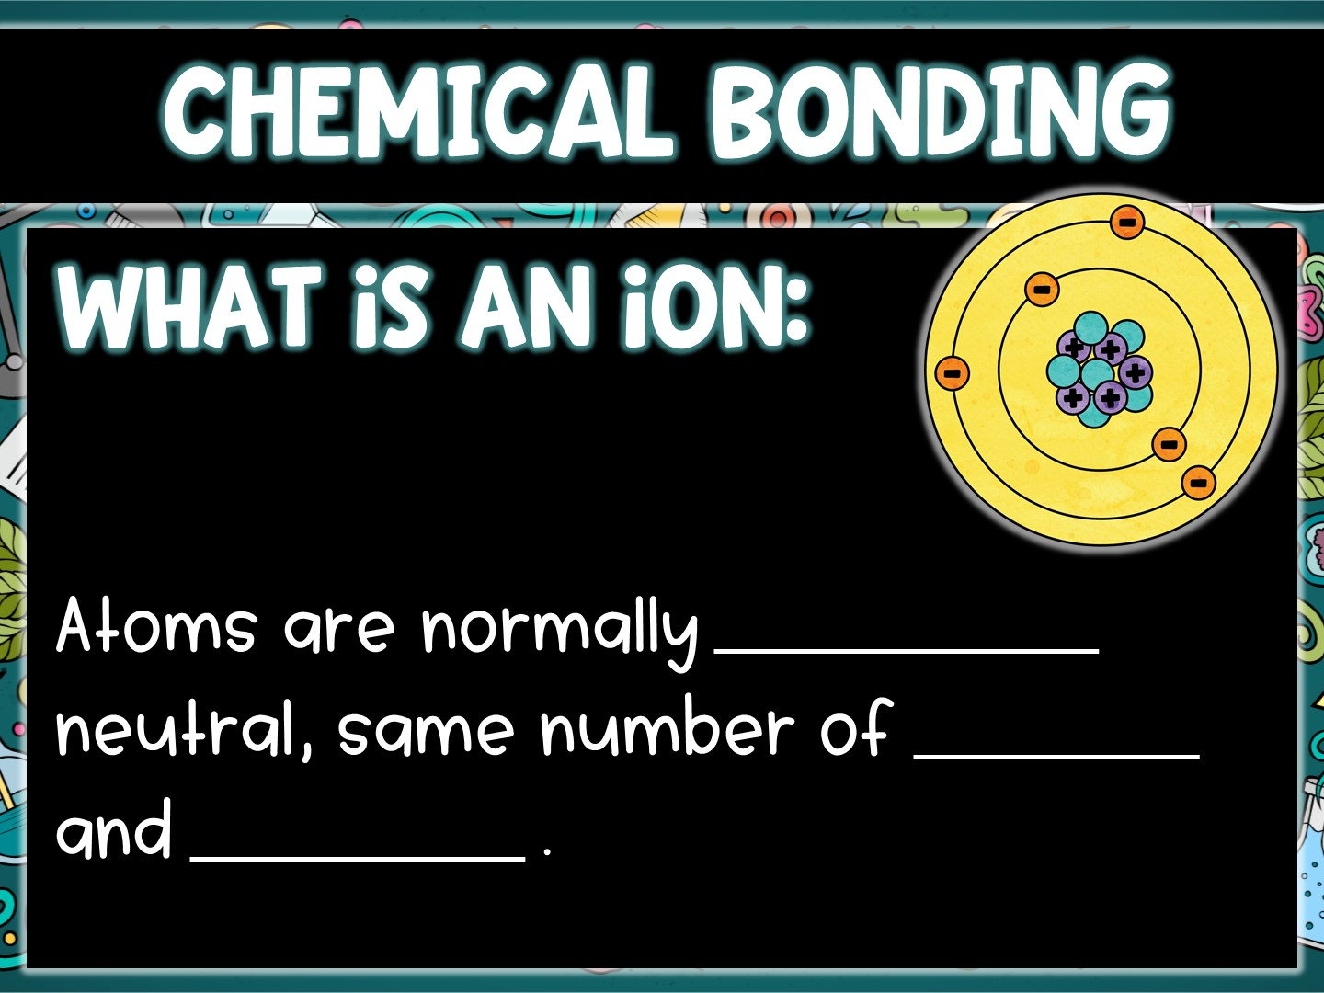
electrically
protons
electrons

Slide 6
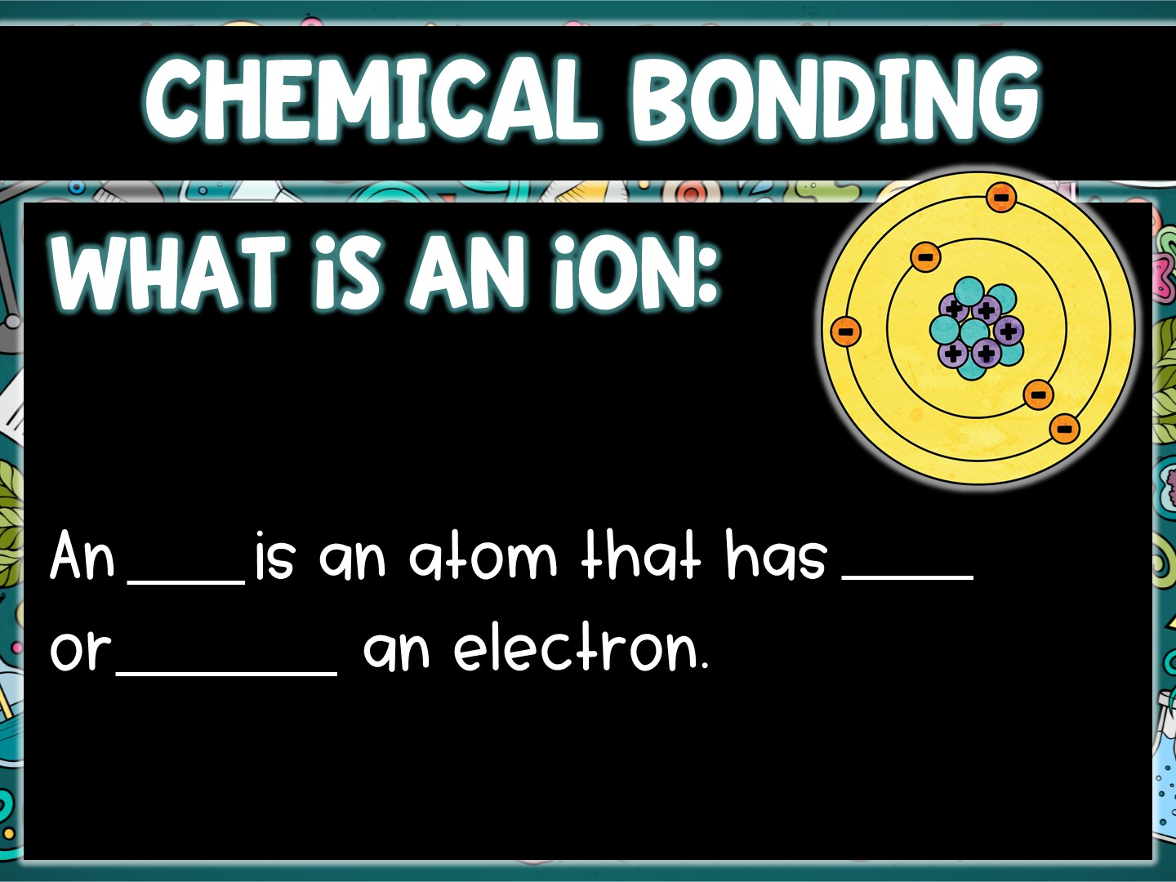
ion
lost
gained

Slide 7
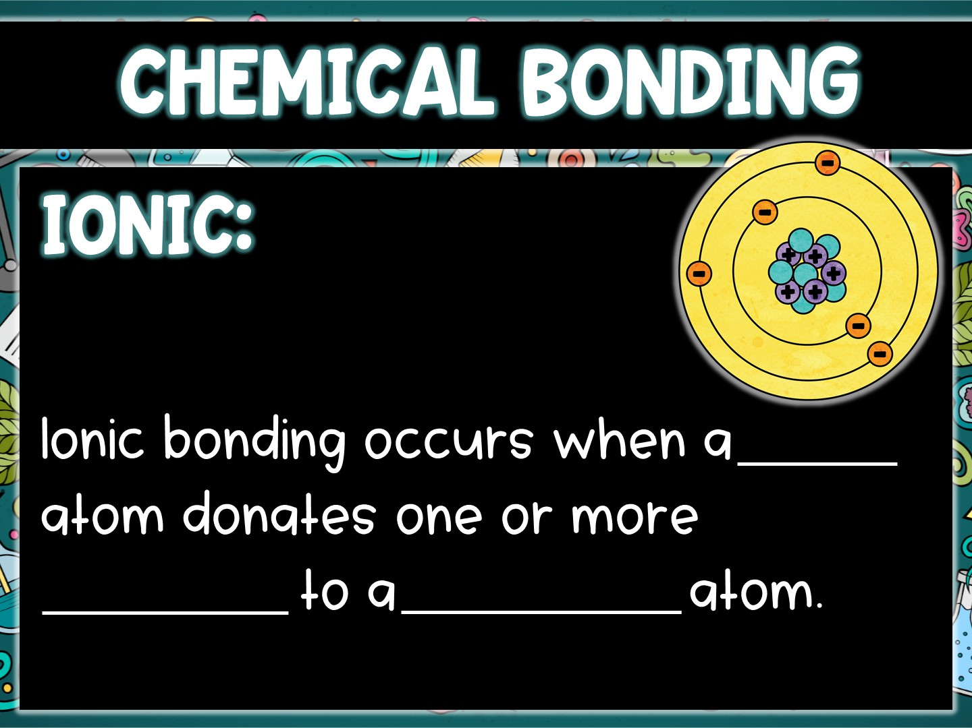
metal
electrons
non-metal

Slide 8
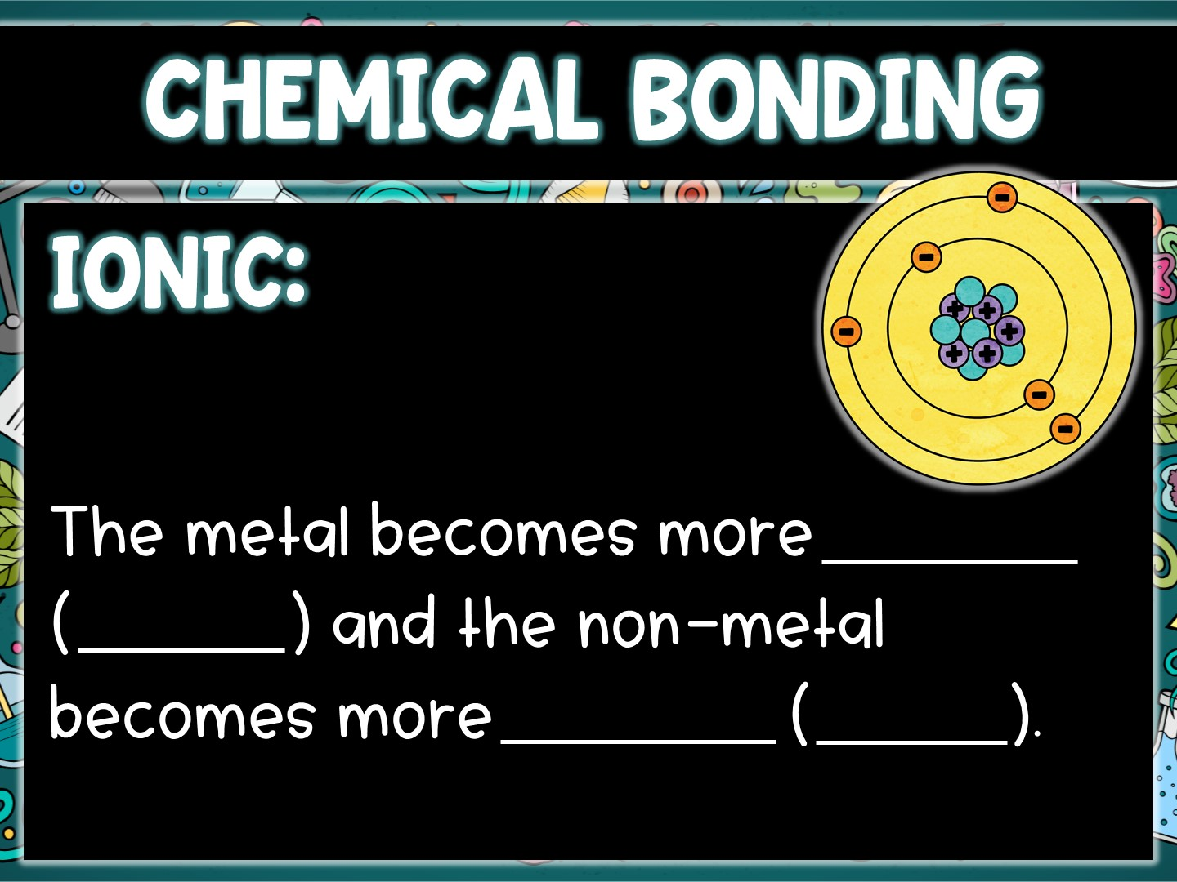
positive
cation
negative
anion

Slide 9
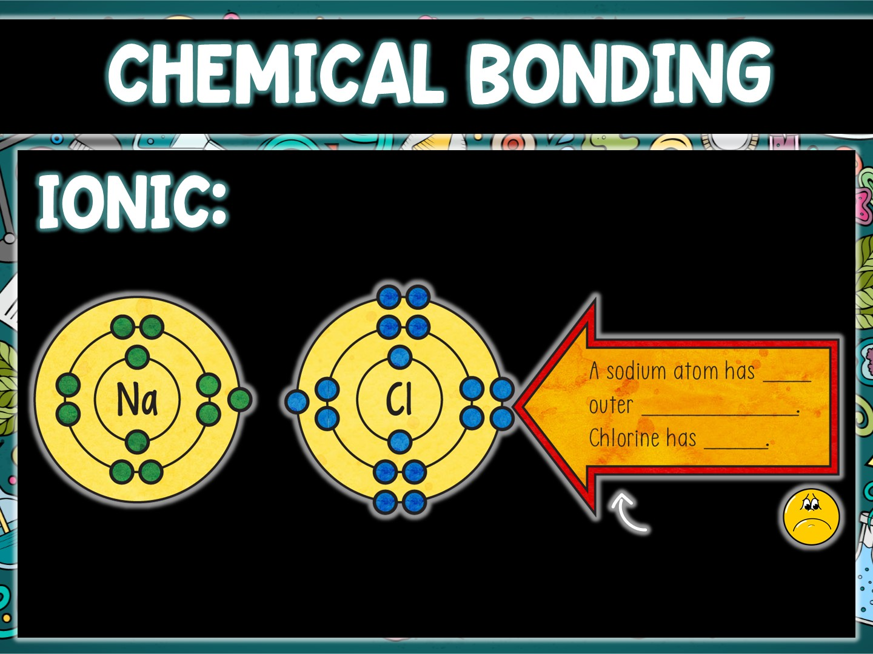
1
electron
7
Neither atom
Is happy!

Slide 10
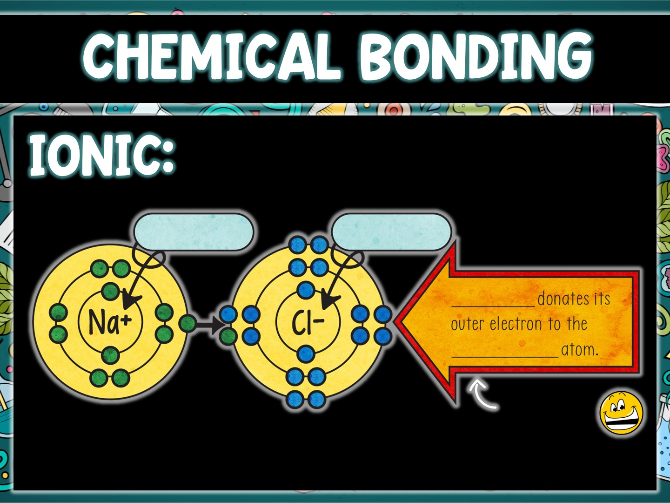
+ cation
- anion
Sodium
chlorine
Both are
now happy!

Slide 11
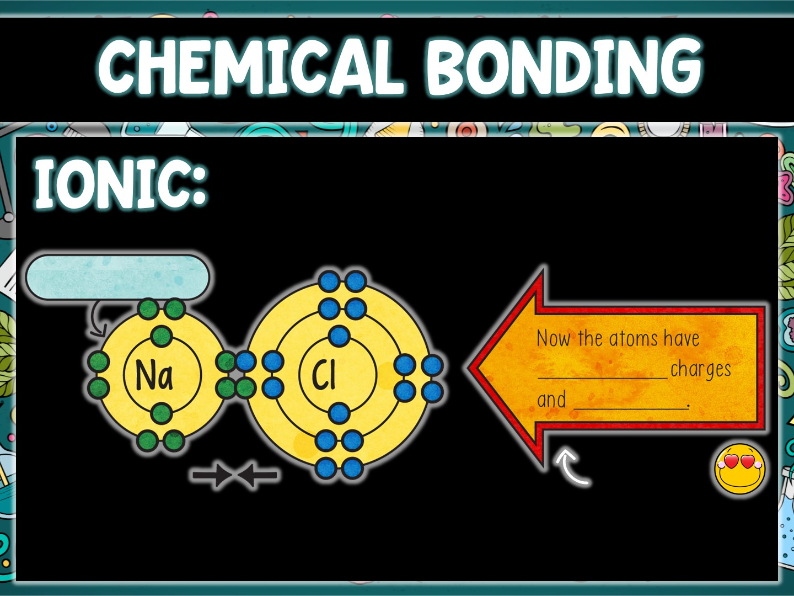
Outer shell is now full!
opposite
attract
NaCl
+1 Charge
-1 Charge
perfect
match!

Slide 12
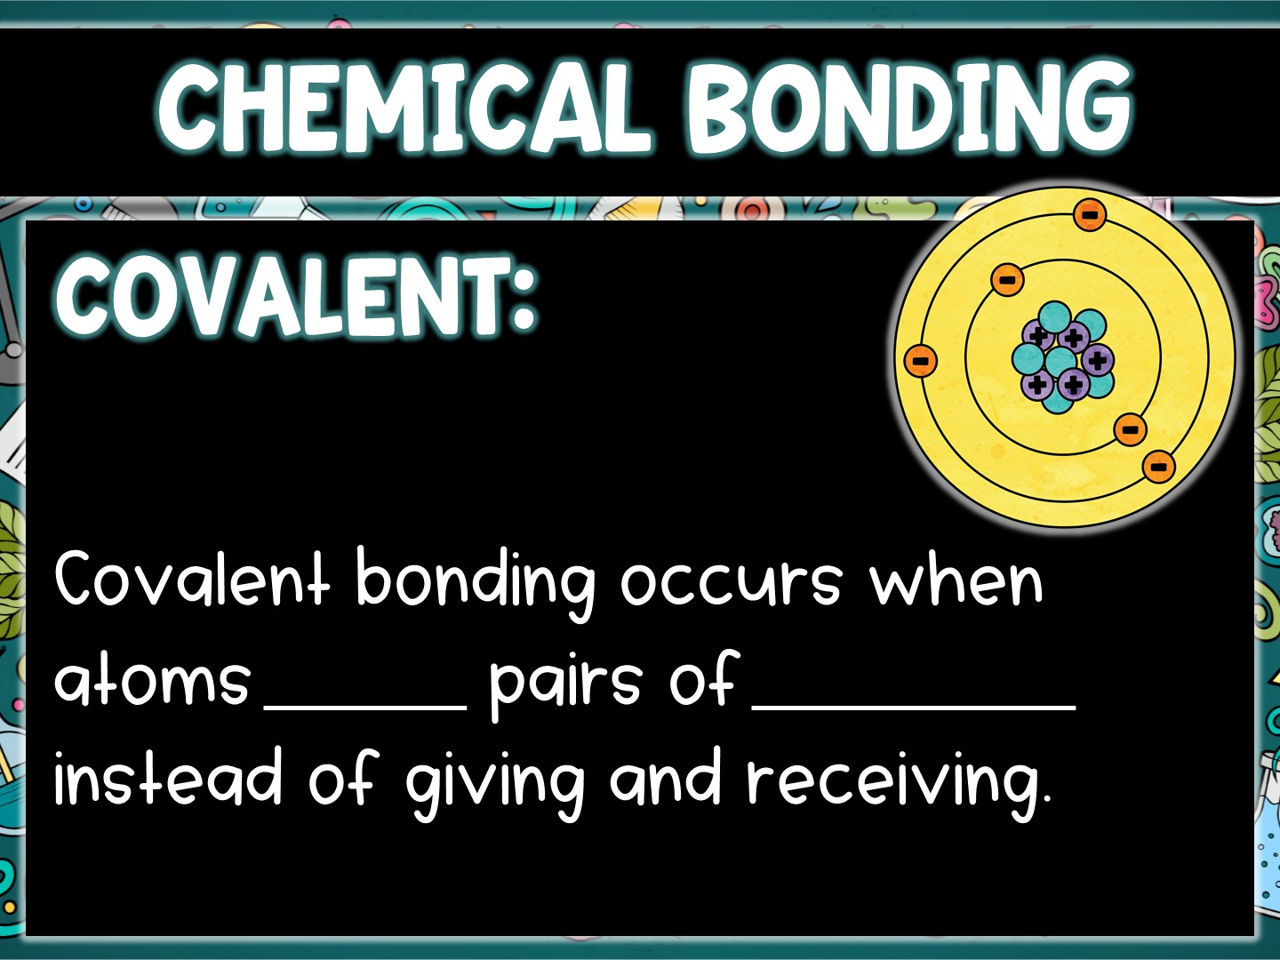
share
electrons

Slide 13
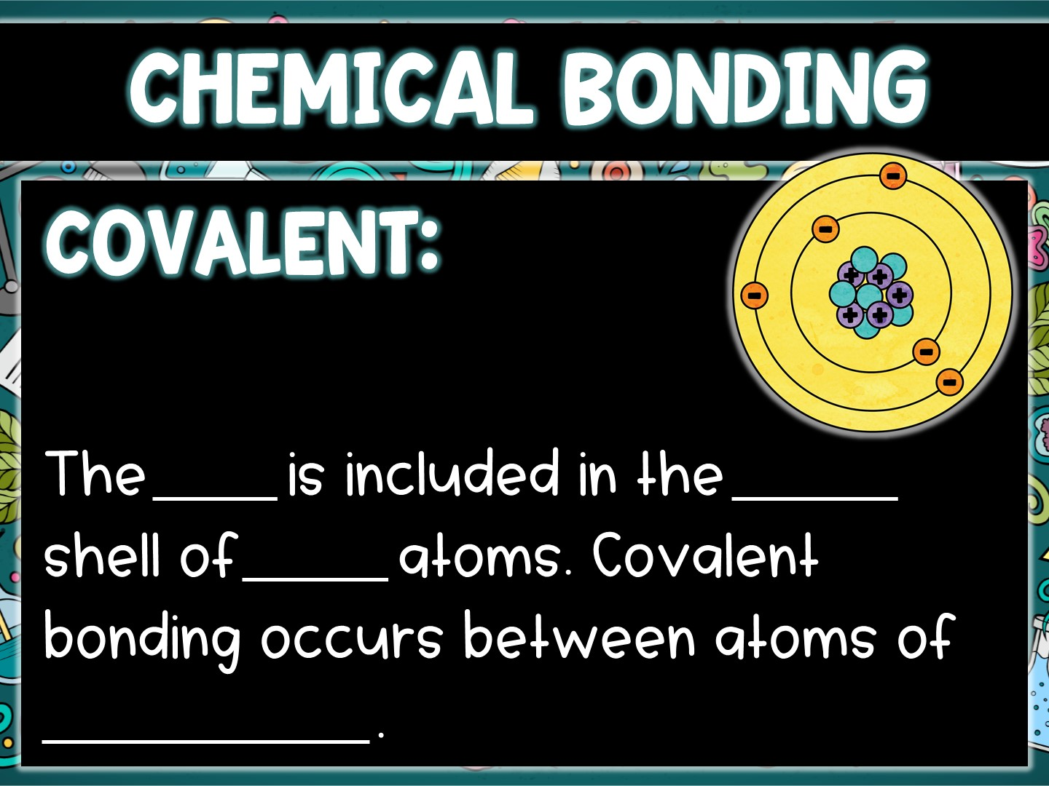
pair
outer
both
non-metals

Slide 14
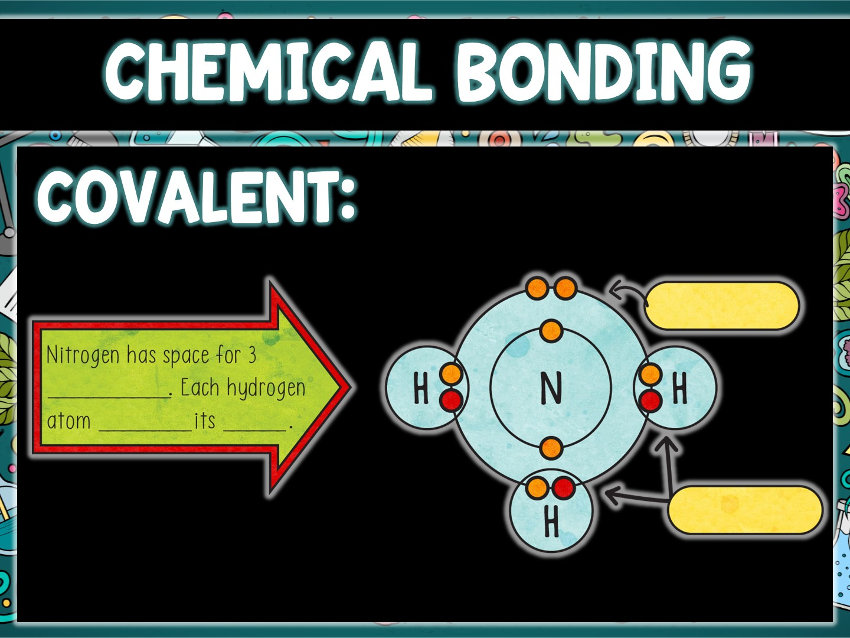
lone pair
electrons
shares
one
bonded pair

Slide 15
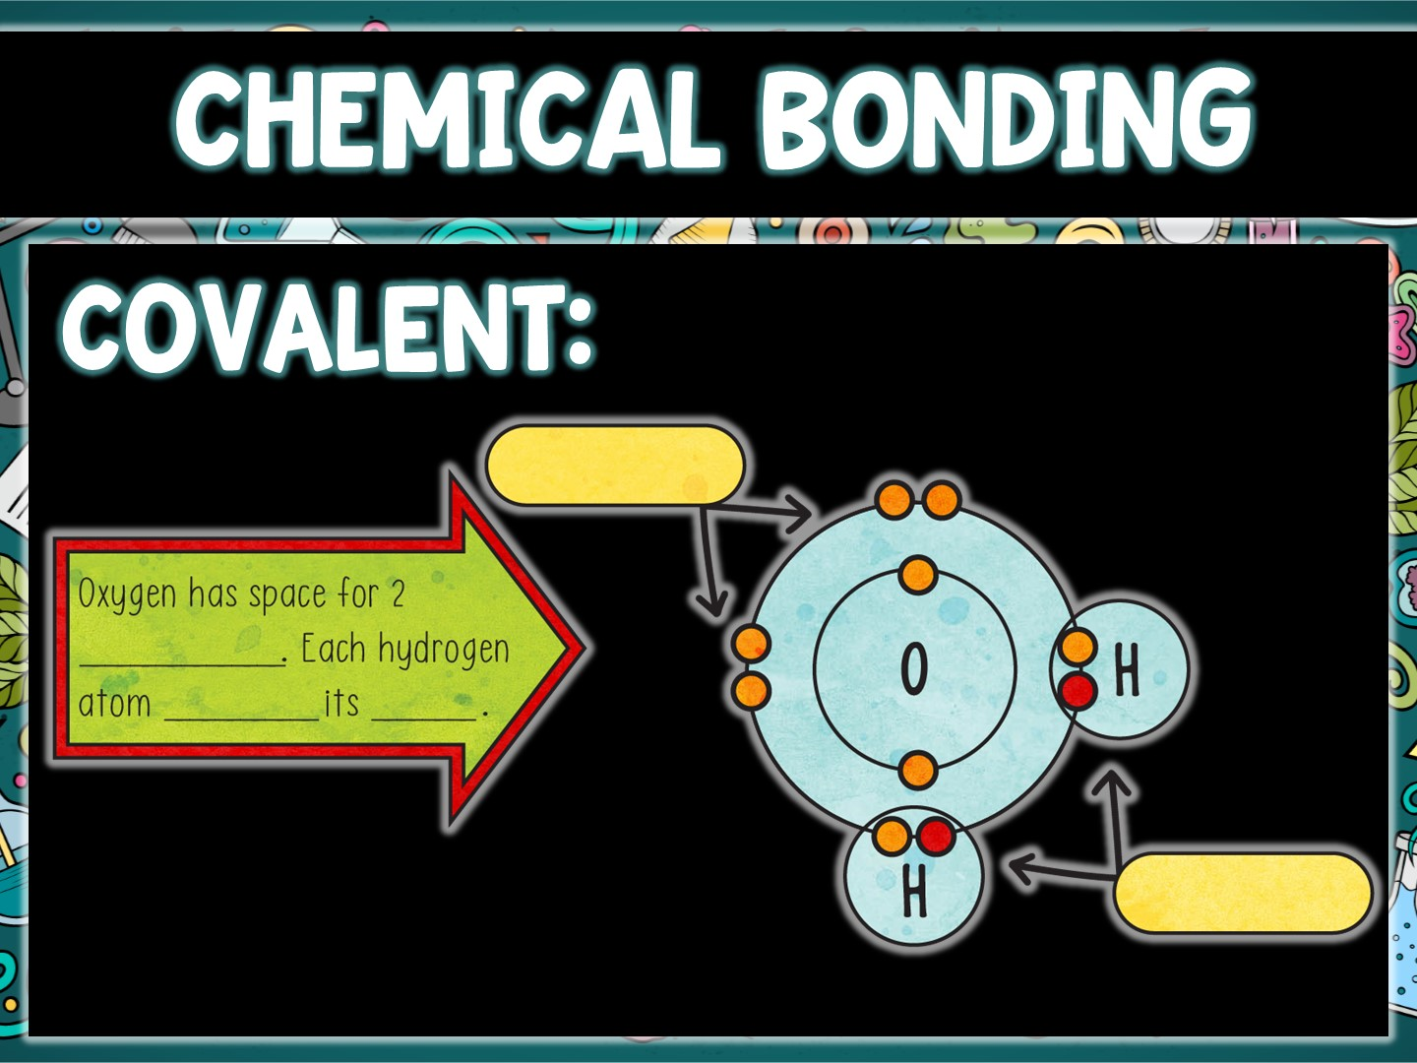
lone pairs
electrons
shares
one
bonded pairs

Slide 16
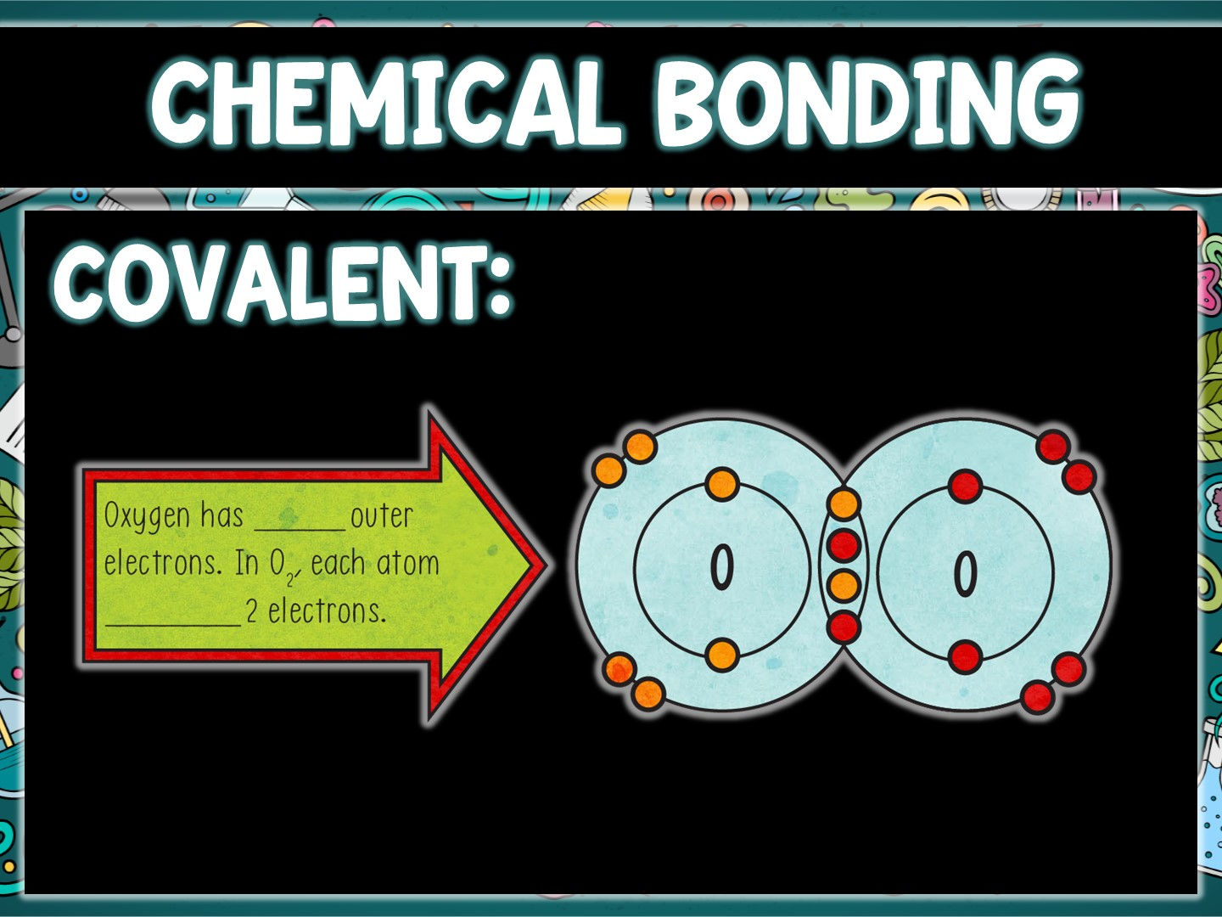
six
shares

Slide 17
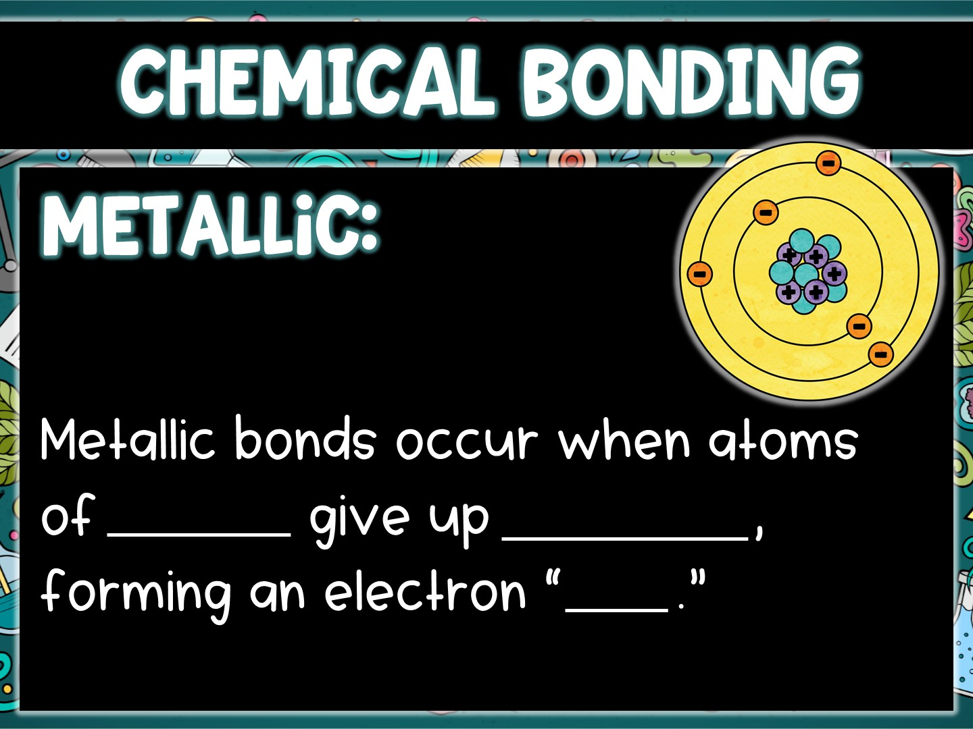
metals
electrons
sea

Slide 18
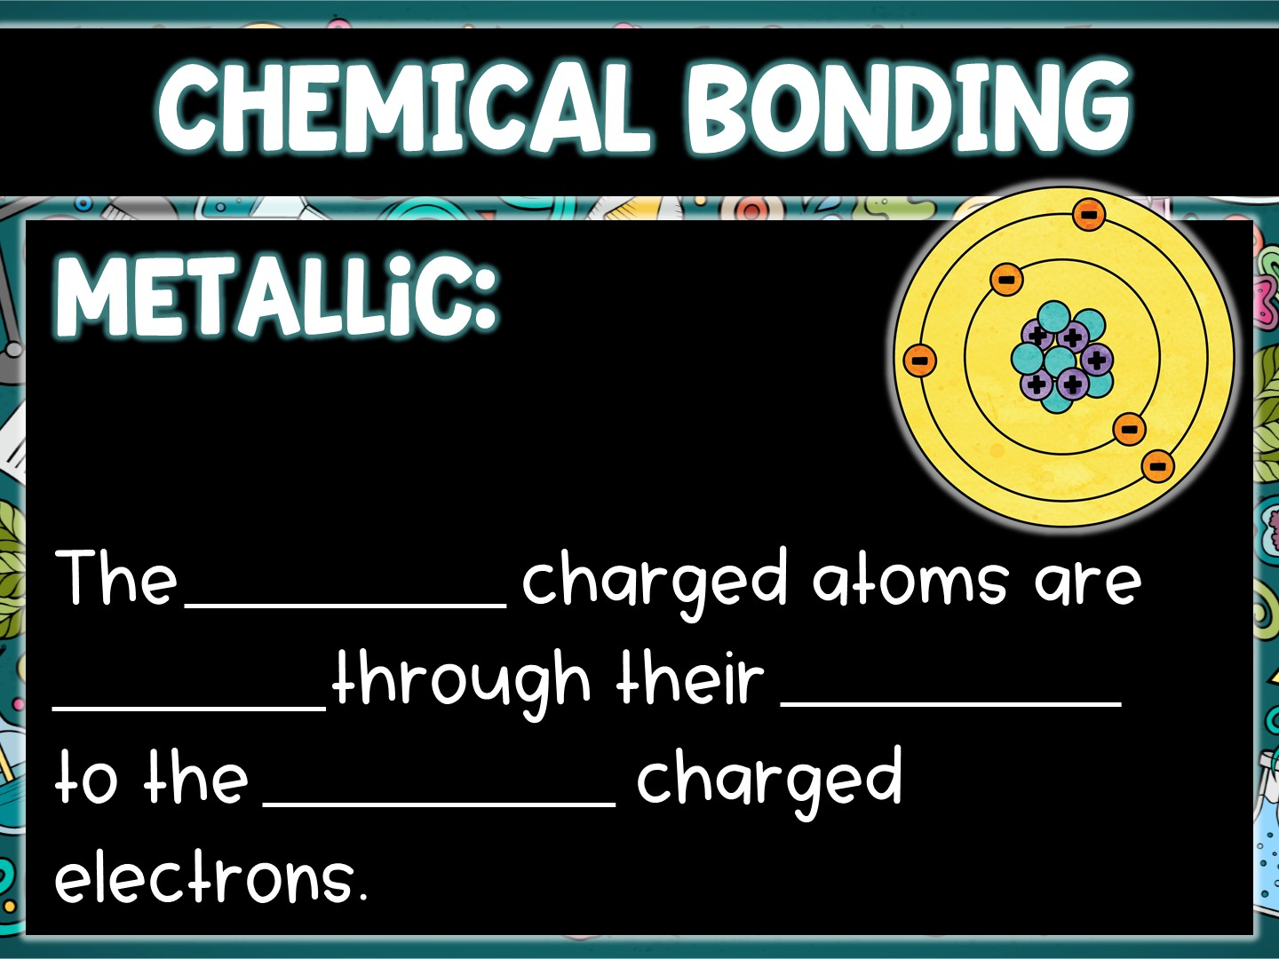
positively
bonded
attraction
negatively

Slide 19
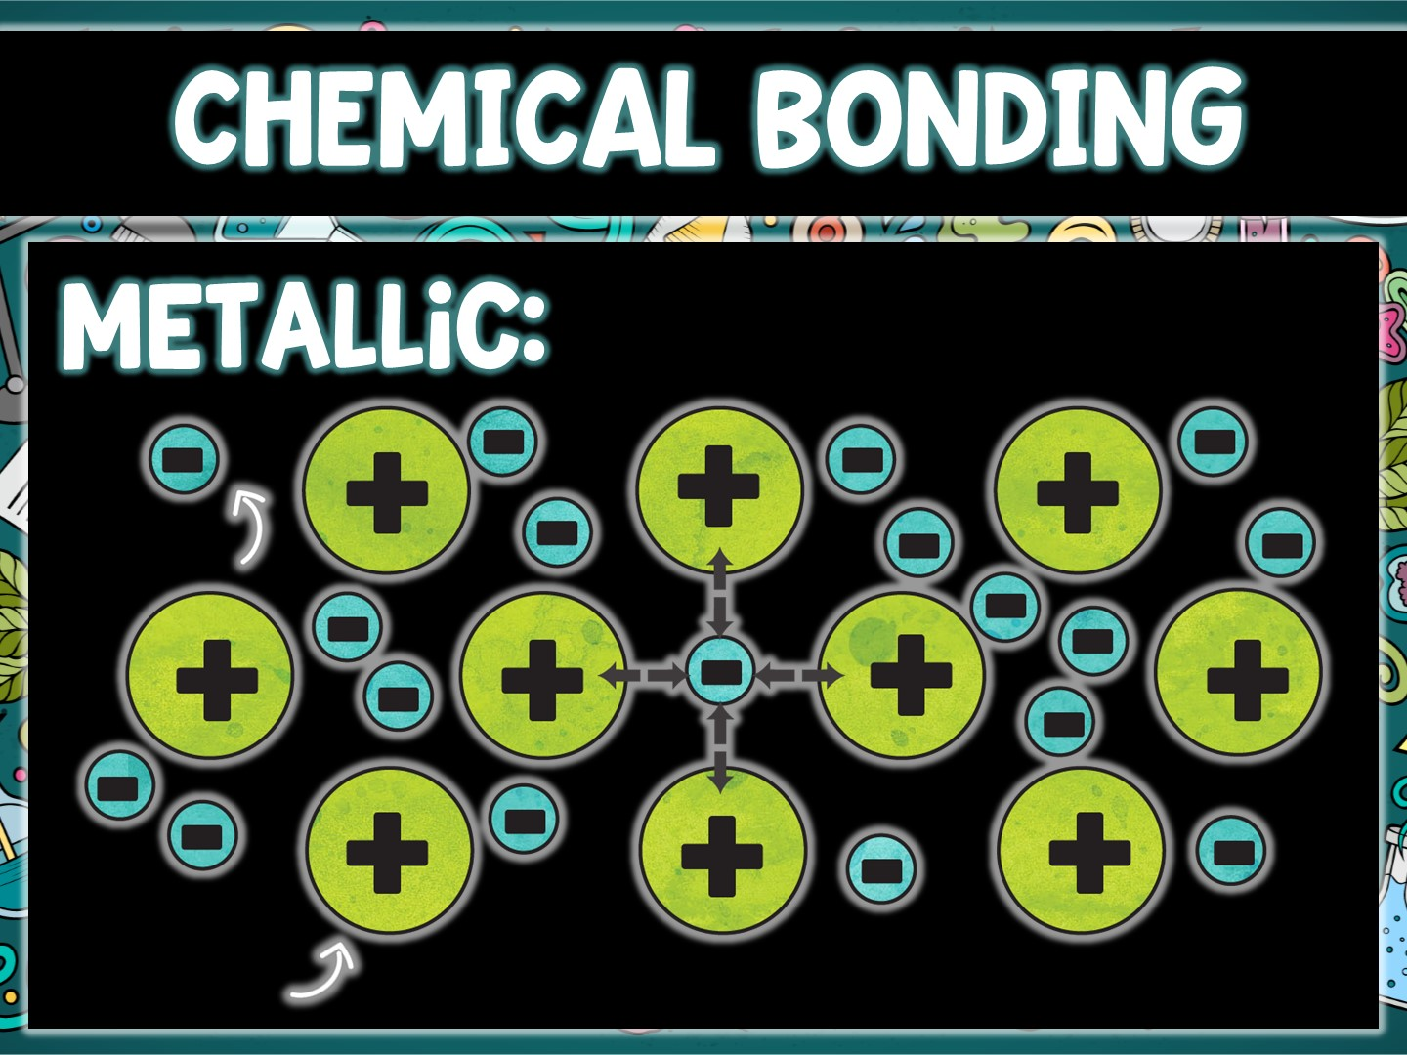
free
electrons -
metal
cation +

Slide 20
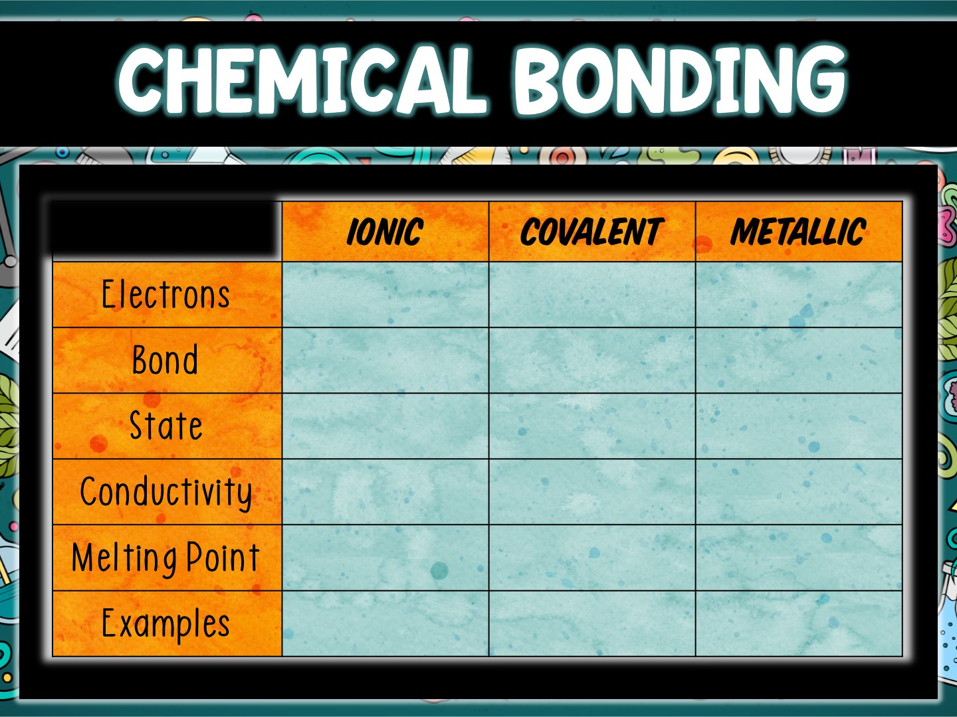
transferred
shared
electron sea
metal to
nonmetal
nonmetal to
nonmetal
metal to metal
crystalline solid
solid, liquid,
or gas
malleable &
ductile solid
yes, when
aqueous
no
yes
high
low
low
NaCl, MgO
H₂O, O₂, CO₂
Cu, Al, Au

